Slide 1
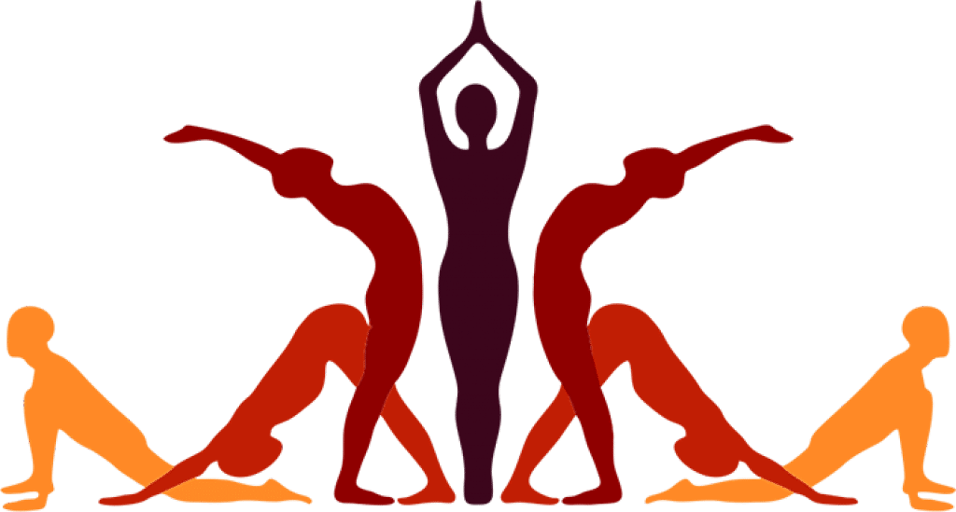
Capstone Project Sem 5
29th January 2021
Capstone Project YoGuru

Slide 2


Capstone Project Sem 5
29th January, 2021
Introduction
Hai Nguyen - BJ19BDS003
Rithwik Chhugani - BS18BDS008
Hai
Rithwik

Slide 3
Capstone Project Sem 5
29th January 2021
Today's Agenda
1
Inspiration / Motivation
3
Selection of Technologies
2
Project Scope
4
Implementation / Results

Slide 4
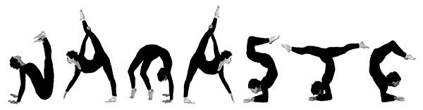

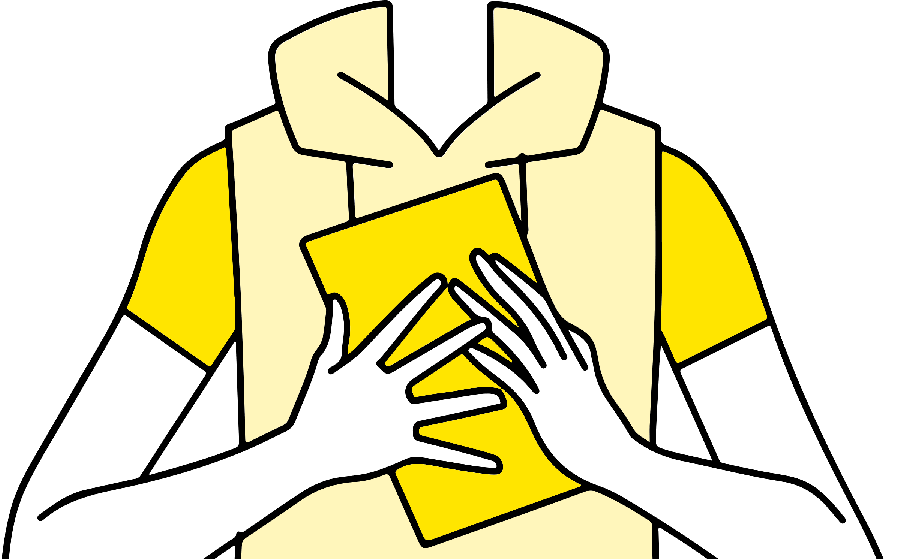
Capstone Project Sem 5
29th January 2021
Namaste

Slide 5
Capstone Project Sem 5
29th January 2021
Motivation
Finding a qualified and available trainer is not always an easy task considering the proximity of accessibility, budget and quality.
1
Availability
3
Accessibility
5
Efficiency
2
Portability
4
Pocket-friendly
6
Quality

Slide 6

Researching about different angles and distances required for posture enhancement
Understanding how OpenPose library works to construct human skeleton structures
Identifying a target population
Researching the market for the idea
Scope
Weighing out the pros and cons of other technologies
How to get the most out of the model and also understanding where it lacked
Built a suggestion function
Adding sample postures for the prototype build

Slide 7
Technology selection
MaskRCNN
AlphaPose
DeepCut
OpenPose

Slide 8
Technology selection
Identify a total of 135 joint keypoints
Real-time
OpenPose library
Best for multi-person detection due to the robust algorithm
Offers 2 body map: COCO & body_25
Introduced by Perceptual Computing Lab of Carnegie Mellon University
VGG-19 CNN based model
Ease of implementation

Slide 9
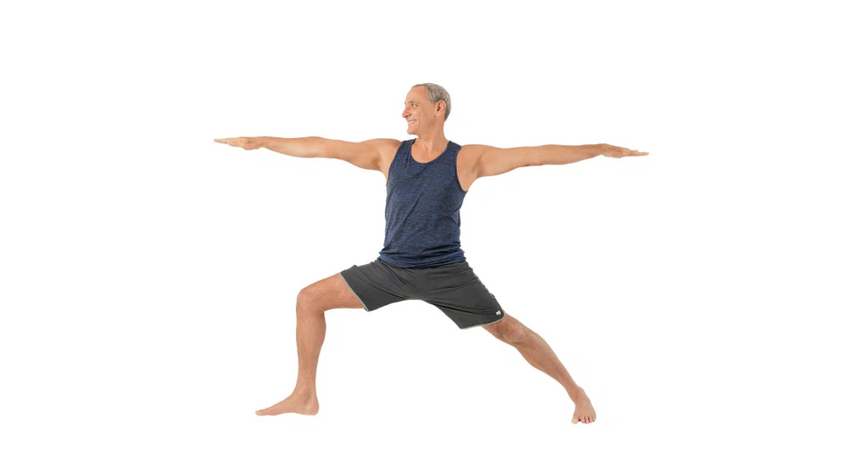
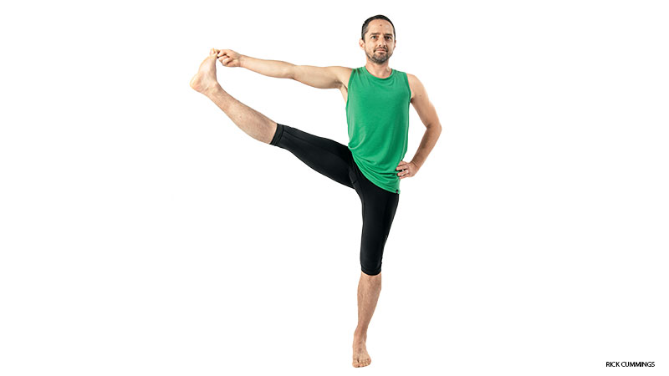

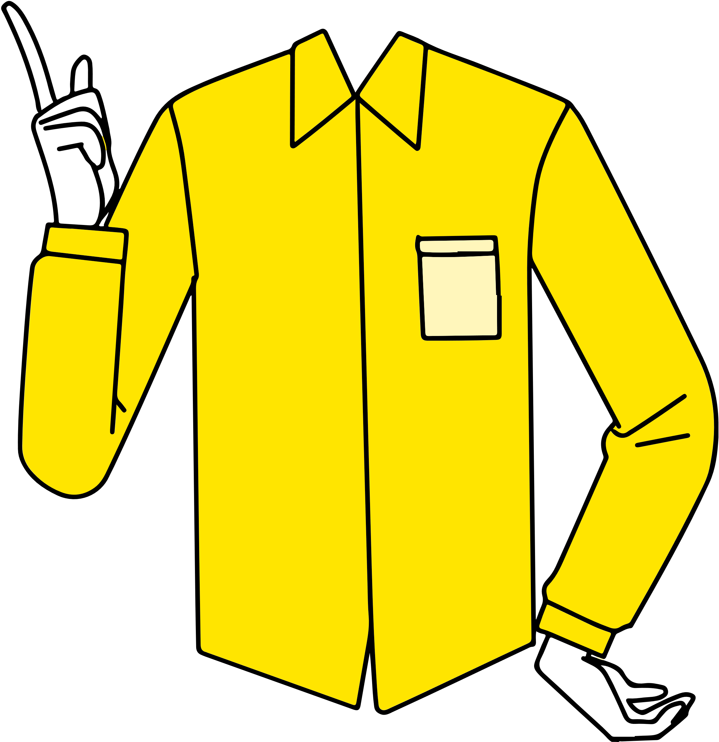

Posture Selection
Figure 1a: Extended Hand to Big Toe Pose
Figure 1b: Warrior II Pose
Chose postures where all 18 body points could be detected by the model
Deciding the range of the angles and distances in the selected postures
Browsed through different available static yoga postures
1
2
3

Slide 10
Methodology
Workflow
Pose estimation
Keypoints detection
Recommendations
1
2
3
6
Pose selection
Angle calculations

Slide 11
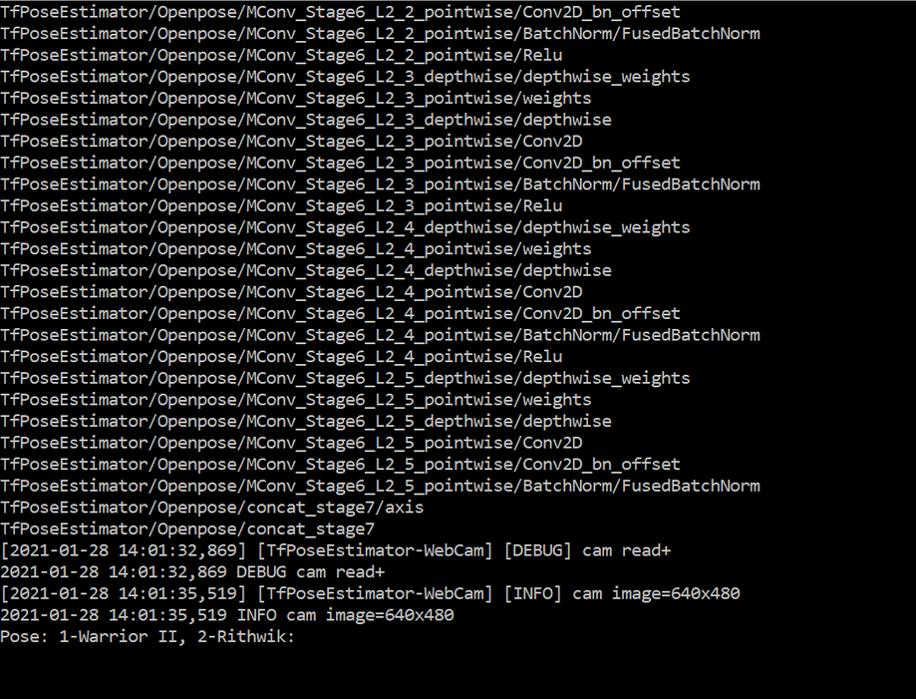
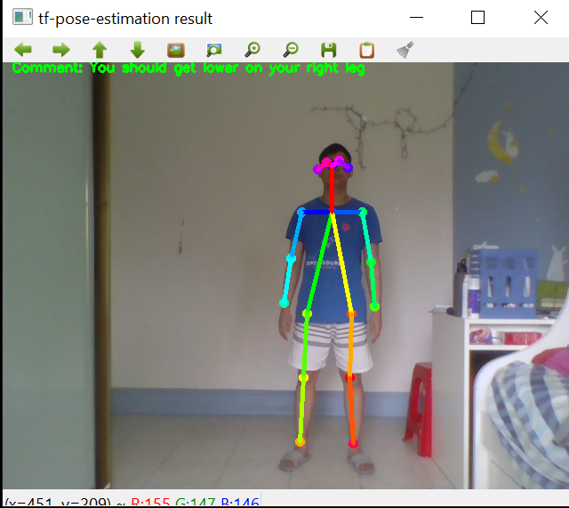
Implementation & Results
Figure 2a: The above picture depicts the mode selection functionality of the app. The current version of the app provides you with 2 modes to select from. Mode 1 is the Warrior Pose and Mode 2 is the Extended Hand to Big Toe
Figure 2b: The above picture shows the skeleton figure imposed on the human body identifying 18 body points.

Slide 12
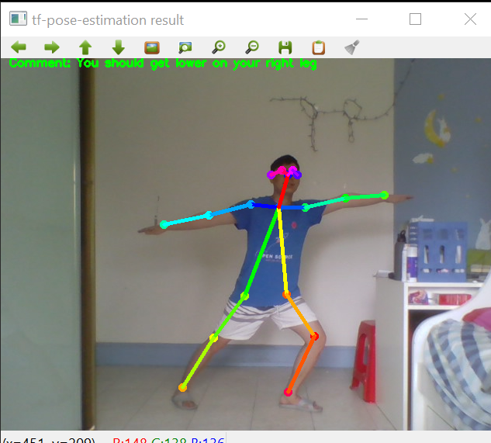
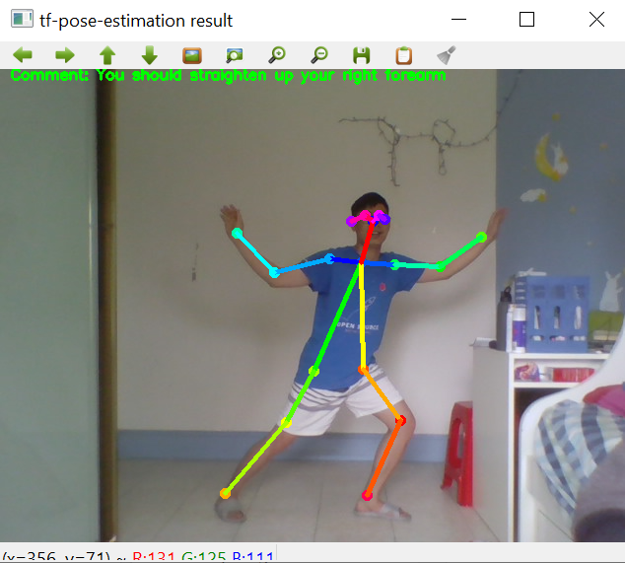
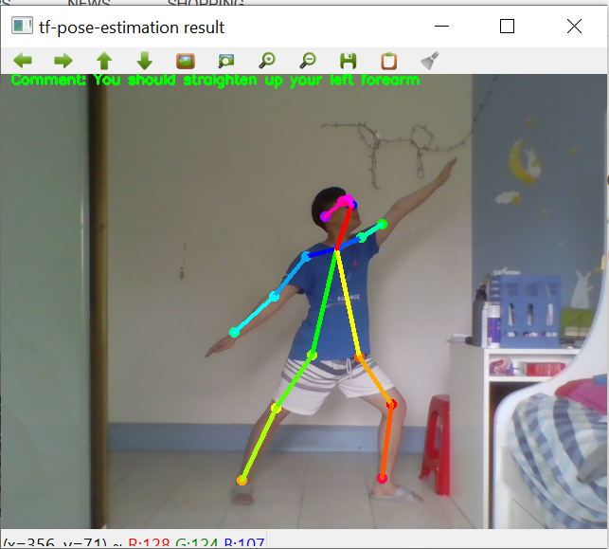
Implementation & Results
Figure 3a: All keypoints detected
Comment: Get lower on the right leg
Figure 3b: All keypoints detected
Comment: Straighten up the right forearm
Figure 3c: All keypoints detected
Comment: Straighten up the left forearm

Slide 13
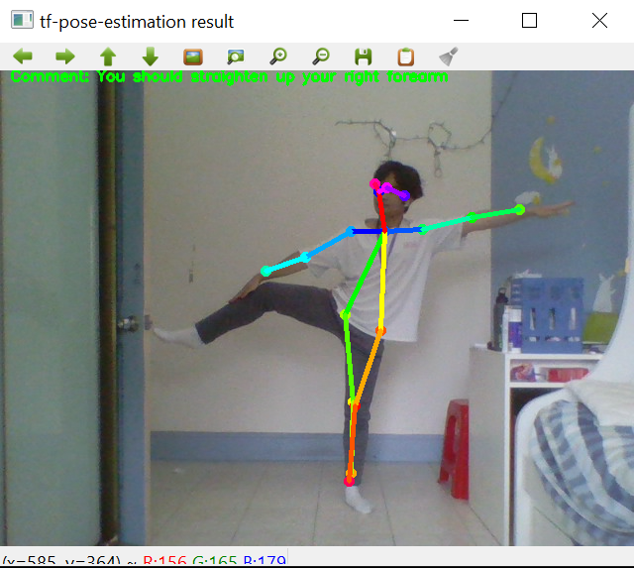
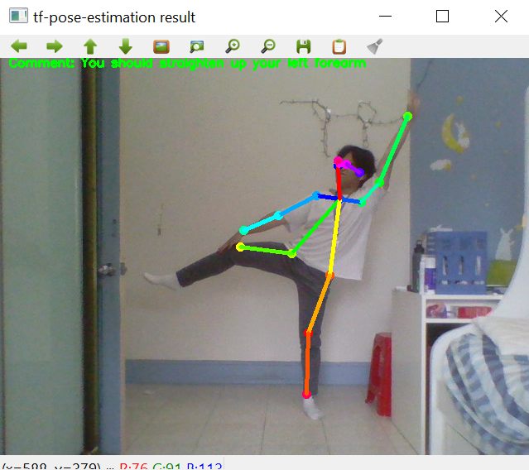
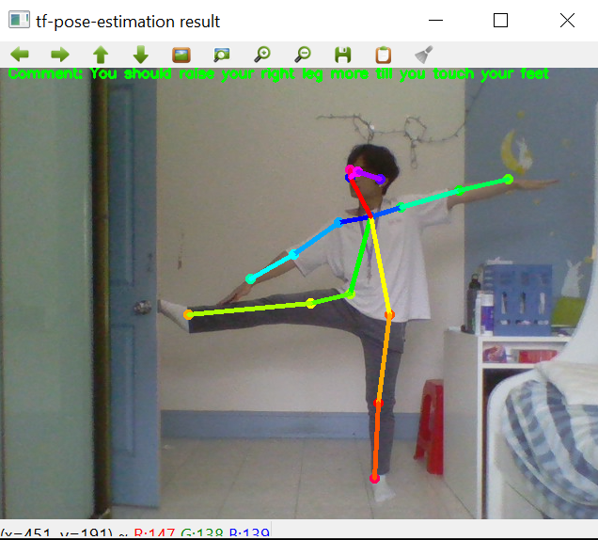
Implementation & Results
Figure 4a: Not all keypoints detected
Comment: You should straighten up your forearm
Figure 4b: Not all keypoints detected
Comment: You should straighten up your left forearm
Figure 4c: All keypoints detected
Comment: You should raise your right leg more till you touch your feet

Slide 14
Dynamic yoga exercises like Suryanamaskar could be added in the future version of the app.
1
2
The app could adopt a mobile version too, for ease of access
Future scope
The app could have two faces to it:
Instructor
User
The app could facilitate group yoga sessions for family and friends
4
3

Slide 15

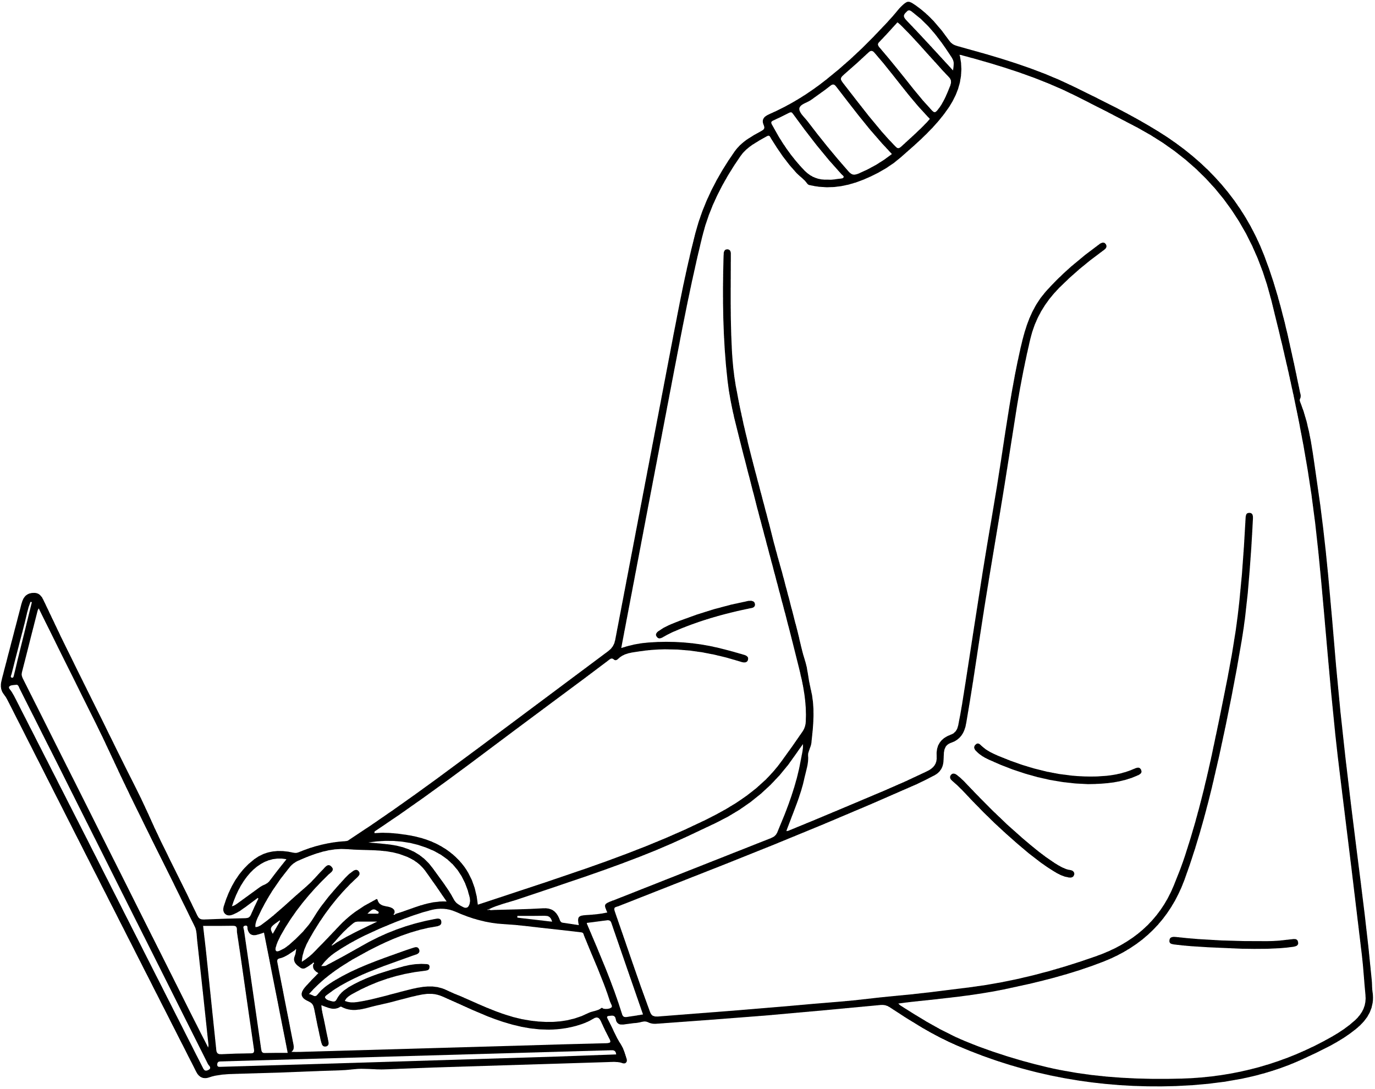
Capstone Project Sem 5
29th January, 2021
Thank you!
Have a great day ahead.

Slide 16
Fall in love with taking care of yourself.
Mind. Body. Spirit
Unknown

